Slide 1
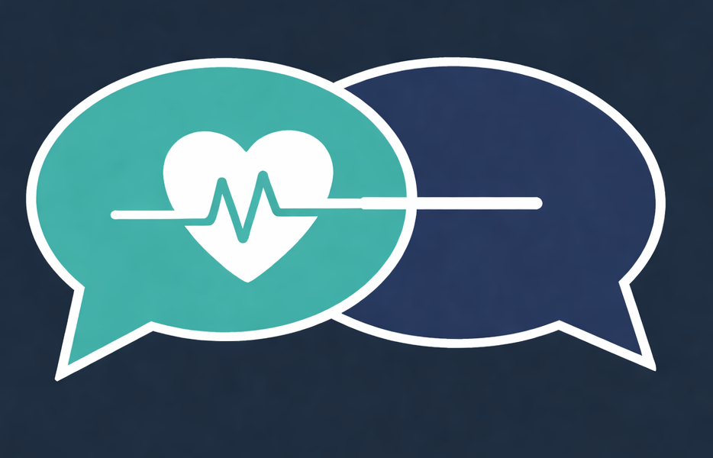

CONVERSATIONS OF DEMENTIA
Answering Your Questions with Knowledge, Compassion & Faith
Because Dementia Is a Brain Disease — Not Normal Aging
Chasity Robinson Mwangi
Founder, Mindful Connection |
Senior Living & Dementia Care Professional
A Presentation for United Believers Community Church | June 2026
“Carry one another’s burdens.” – Galatians 6:2
Notes:
OPENING — ~1.5 min
Good morning, church family — thank you for inviting me to walk into this conversation with you.
Today we'll talk about dementia not as something to fear, but as something we can understand together — with knowledge, with compassion, and with faith.
"Carry one another's burdens and so fulfill the law of Christ." — Galatians 6:2
That verse is the heart of why we're here. Many of you are already carrying burdens for a parent, a spouse, a sibling. My prayer is that you leave today better equipped to carry — and to be carried.

Slide 2

Who I Am — Why This Work Matters
Chasity Robinson Mwangi
Founder, Conversations of Dementia | Mindful Connection
Senior living & dementia care professional
25+ years guiding families through care transitions
Advocate for dementia education & understanding
My Work Focuses On
Helping families understand behavior changes
Walking caregivers through difficult transitions
Connecting families, care teams & community resources
Honoring the dignity of every person as God’s Creation
Notes:
WHO I AM & WHY THIS MATTERS — ~2 min
My name is Chasity Robinson Mwangi. For over 25 years I've walked with families through dementia — in their living rooms, in hospital hallways, in memory-care neighborhoods. I founded Mindful Connection because I kept seeing the same heartbreaking pattern: families who loved each other deeply but had no roadmap. Their loved one was changing, and they didn't know what was happening, what to call it, or where to turn.
This work matters because dementia is no longer a small or distant problem. More than 7 million Americans are living with Alzheimer's right now. By 2050 that number could nearly double. In the Black community specifically, we are TWICE as likely to develop Alzheimer's — and LESS likely to get an early diagnosis. That gap costs family's peace, time, and savings.
Most of all, I do this work because every person is created in God's image. Dementia takes a lot, but it does not take that! Our job today is to learn how to honor that image — even when the person we love can no longer recognize themselves.
So let's start with what brought us here — YOUR questions.

Slide 3
The Questions You Brought Me
You Asked — We’ll Answer
Understanding dementia
Daily care & decisions
1
Early signs of Alzheimer’s &
dementia
5
Responding when reality
seems false
2
Detection timing and age
6
Encouraging hygiene &
bathing
3
Medication that may slow
progression
7
Staying mentally active
4
Heredity and family risk
8
Facilities, Medicare &
Medicaid
Notes:
THE 8 QUESTIONS — ~1 min
Before this talk, your pastor sent me your real questions. I received eight. We'll take them in order.
Read each item briefly — 5 seconds per line, no commentary yet:
1. Early signs of Alzheimer's & dementia
2. How early can it be detected? What age?
3. Is there medication to slow it?
4. Is it hereditary?
5. Responding when their reality is false
6. Gently encouraging hygiene & bathing
7. Staying mentally active
8. Facilities, Medicare & Medicaid
Some answers will be short. Some need us to slow down. All of them belong in this conversation.
Transition: "Let's begin with what dementia actually IS."

Slide 4


What dementia is
AREAS OF CHANGE
1
Memory
2
Thinking
3
Judgment
4
Behavior
5
Daily activities
KEY TAKEAWAY
Dementia is not a normal part of aging
Notes:
WHAT DEMENTIA IS — ~2 min
Dementia is not a single disease. It is an umbrella term for a decline in brain function severe enough to interfere with daily life.
Five abilities: Memory. Thinking. Judgment. Behavior. The ability to perform daily activities.
Dementia is NOT a normal part of aging. It is a brain disease — or a group of brain diseases. If your loved one is forgetting where they live, getting lost on familiar streets, or no longer recognizing family — that is not 'just getting old.' That is a medical condition that deserves a medical evaluation.
Briefly name: Alzheimer's is the most common — 60 to 80% of cases. Others include vascular dementia, often after a stroke; Lewy body dementia, with visual hallucinations and movement issues; frontotemporal dementia, which changes personality and behavior first; and mixed dementia. The treatments and progressions differ — which is why getting a real diagnosis matters.
Remember — if you've met one person with dementia, you've met ONE person with dementia. Every brain, every story, every family is different.

Slide 5
COMMON TYPES OF DEMENTIA
Ten names families may hear — compare what changes first and how it tends to worsen.
Patterns guide the next conversation with a clinician; they are not a diagnosis by themselves.
1. Alzheimer's disease
2. Vascular dementia
Memory and new learning usually stand out first.
Often tied to strokes or blood-vessel disease.
often gradual
may worsen in steps
3. Lewy body dementia
4. Frontotemporal dementia
Hallucinations, dream acting, movement, or alertness shifts.
Personality, judgment, behavior, or language changes first.
may fluctuate
behavior/language first
5. Mixed dementia
6. Parkinson's dementia
More than one brain change happens at the same time.
Thinking changes come later in Parkinson’s disease.
combined causes
later in Parkinson's
7. Creutzfeldt-Jakob disease
8. Huntington's disease
Rare prion disease with much faster decline.
Inherited condition with mood, movement, and thinking changes.
rapid decline — urgent
inherited + movement
9. Normal-pressure hydrocephalus
10. Alcohol-related / Wernicke-Korsakoff
Walking trouble, urinary issues, and thinking changes.
Memory problems linked to thiamine deficiency and heavy alcohol use.
may be treatable
needs medical care
Helpful community takeaway: ask, ‘what changed first?’ and ‘was the change gradual, stepwise, fast, fluctuating, or linked to alcohol use?’
Sources: National Institute on Aging; Alzheimer’s Association; NIAAA | Educational only — encourage medical evaluation for new changes
Notes:
COMMON TYPES OF DEMENTIA — ~75 sec
I'm not asking you to memorize a textbook — I want you to recognize the FAMILY STORY behind each type.
• ALZHEIMER'S (60-80%): "She keeps repeating herself. She can't remember the grandkids."
• VASCULAR: "He was steady — then suddenly worse after his stroke."
• LEWY BODY: "She sees children in the house who aren't there. She acts out her dreams."
• FRONTOTEMPORAL: "He's not himself. He says rude things now. He used to be so kind." Often 50s-60s.
• MIXED: two types at once — common in older brains.
• PARKINSON'S / HUNTINGTON'S / CJD: rarer; tremor, inherited mood + movement, or rapid decline.
• ALCOHOL-RELATED / WERNICKE-KORSAKOFF: "He's been drinking heavily for years, and now he can't form new memories." Caused by thiamine (B1) deficiency. Catching it early — and stopping the drinking — can halt or even partially reverse it.
TWO YOU DON'T WANT TO MISS — both can be treated or reversed:
• NPH (Normal-Pressure Hydrocephalus): walking trouble + bathroom changes + thinking trouble. A shunt can reverse symptoms.
• Alcohol-related: thiamine treatment + sobriety can stop or partially reverse it.
Two people with dementia may need very different care plans. That's why diagnosis matters.

Slide 6
Early signs of Alzheimer's & Dementia
Question 1
Question 1
EARLY SIGNS OF ALZHEIMER'S & DEMENTIA
The Alzheimer's Association lists 10 warning signs. Here are the ones families notice first:
WATCH FOR PATTERNS, NOT ONE-OFF MOMENTS
1
Memory loss
2
Trouble planning
Forgetting new information or asking the same question repeatedly.
Losing track of a familiar recipe, budget, or monthly bills.
3
Familiar tasks
4
Time or place
Difficulty completing routines at home, work, or church.
Confusion about where they are or getting lost on a familiar street.
5
Words and names
6
Social withdrawal
Stopping mid-sentence or calling things by the wrong name.
Pulling back from work, hobbies, social life, or personality changes.
Source: Alzheimer’s Association warning signs, summarized for family discussion
Notes:
Q1 — EARLY SIGNS vs NORMAL AGING — ~2.5 min
Question 1. What are the early signs?
The Alzheimer's Association lists ten warning signs. The ones families notice first are on the screen.
These look so much like normal aging — that's why families miss them. Let me show you the difference.
WARNING SIGN vs NORMAL AGING
• Asking the same question repeatedly vs Occasionally forgetting a name but remembering it later
• Pattern of poor judgment vs Making an occasional bad decision
• Losing the ability to follow a familiar recipe vs Needing help with a new phone or TV setting
• Stopping mid-sentence, calling things by the wrong name vs Sometimes searching for the right word
• Withdrawing from work, hobbies, or church vs Tiring of obligations now and then
One or more signs that INTERFERE with daily life is reason to see a doctor — not something to wait out.
Why are early signs missed? Three reasons. Changes are gradual. Families normalize them — 'that's just Mom.' And there's still stigma around testing. We'll address all three today.

Slide 7

When the brain changes, behavior changes
Different Parts of the Brain Control Behavior
BEHAVIOR
BRAIN PART
Memory
→
Hippocampus
Judgment
→
Frontal Lobe
Emotion
→
Amygdala
Notes:
BRAIN CHANGES → BEHAVIOR CHANGES (+ medical triggers) — ~2 min
Before we get into specific behaviors, I want to give you a way to UNDERSTAND them. When you understand WHY someone is acting differently, you stop taking it personally.
Different parts of the brain control different things. Memory lives in the hippocampus. Judgment lives in the frontal lobe. Emotion is controlled in the amygdala. When dementia damages a region, you see a change in the behavior that those regions controls.
Common behaviors families see: repetition, wandering, sundowning (agitation late in the day), withdrawal, resistance to care, and personality shifts.
IMPORTANT — Behavior changes are sometimes NOT the dementia itself. They can be triggered by something medical: dehydration, a urinary tract infection, medication side effects, vision changes, balance issues. A SUDDEN change in behavior should always send you to the doctor first — before assuming it's progression of the disease.

Slide 8
Question 5
Call the doctor — or call 911?
Use speed and severity to decide whether this is a medical appointment or an emergency.
CORE MESSAGE
CALL THE DOCTOR
CALL 911
Sudden change is a safety signal.
New, concerning, but stable
Sudden or dangerous
• Stroke signs: face, arm, speech
• Chest pain or trouble breathing
• Fainting, seizure, or severe fall
• Violent behavior or immediate danger
• Gradual memory change
• Medication side effects
• New wandering or falls
• Sleep, pain, or mood changes
• Caregiver needs guidance
If symptoms come on fast, feel severe, or threaten immediate safety, do not wait for the next appointment.
WHEN UNSURE: ESCALATE
Rule of thumb: sudden + severe = urgent. If safety is at risk, call 911 first.
For non-emergency concerns: write down what changed, when it started, and what makes it better or worse.
Notes:
CALL THE DOCTOR — OR CALL 911? — ~1 min
Before we talk about how doctors diagnose, families ask me a different question first: when do I call? Here's a quick reference.
LEFT — same-day or this-week doctor call:
• Sudden new confusion or behavior change (often a sign of infection)
• Sundowning or sleep disruption that won't settle
• Falls without injury — call before the one WITH injury
• Possible UTI — in older adults, confusion is often the FIRST sign before pain
• New medication side effects
• Weight loss, withdrawal, or stopped eating
RIGHT — call 911 right now:
• Head injury after a fall
• Sudden weakness, slurred speech, facial droop — STROKE signs
• Wandering in cold, heat, or unsafe areas
• Aggression that endangers anyone
• Choking or aspiration
• Thoughts of self-harm or harm to others
KEY PRINCIPLE: When in doubt, lean toward the more urgent side. You will never regret calling too soon.
This list is also in my free Dementia Patterns Checklist — available to you today.

Slide 9
First steps
Turn “something is off” into evidence
A simple pattern log helps families move from worry to a clearer medical conversation.
CORE MESSAGE
STEP 1
Do not diagnose from memory alone.
Start a Pattern Log
Capture date, time, what happened, and what helped. Bring the log to the appointment.
Write down specific changes. Patterns help doctors separate dementia, delirium, depression, medication effects, and normal aging.
STEP 2
STEP 3
Talk with care
Call primary care
MAKE IT SPECIFIC
Use calm, specific examples. Do not argue.
Ask for an assessment. Bring the pattern log.
Audience moment: picture one person — then picture writing down what you noticed this week.
A one-page log is often more useful than a long story told from memory.
Notes:
IF YOU SUSPECT SOMETHING IS OFF — FIRST STEPS — ~2 min
This is the slide families tell me changed everything. Most people get stuck right here — 'I think something is wrong, but I don't know what to DO about it.’
Don't rely on memory. WRITE IT DOWN. The doctor cannot help you with 'she's been off lately.' The doctor CAN help you with 'three times this week, around 4 PM, she got agitated and couldn't recognize her own kitchen for about 20 minutes.'
5 steps:
1. Start a Pattern Log
2. Talk with care — not accusation
3. Call the doctor — ask for a cognitive assessment (Medicare covers it FREE at the annual visit)
4. Bring someone with you — a second observer matters
5. Bring your log to the appointment
INTRODUCE THE DEMENTIA DECODED FRAMEWORK (turn to right side of slide)
This is the framework I teach in my Dementia Decoded series. For every observation, capture five things:
• WHAT did you actually observe?
• WHEN — date AND time of day (afternoon agitation, morning confusion — patterns matter)
• HOW OFTEN — daily? weekly? once?
• HOW LONG — minutes? hours? all day?
• IMPACT — did it disrupt daily life? safety? relationships?
That's the difference between a vague worry and clear evidence a doctor can act on.
The free Dementia Patterns Checklist that walks you through this.

Slide 10
How Early Can it be detected? At what age?
Question 2
HOW EARLY CAN IT BE
DETECTED? AT WHAT AGE?
YEARS
Brain changes can begin 15-20 years before the first symptom appears
65+
Most cases are “late-onset,” with symptoms after age 65
40s-50s
Rare “early-onset” forms can begin as young as the 30s-50s
How Doctors Detect It Today
Cognitive Screening
Brief memory & thinking tests during a check-up including Medicare’s free annual cognitive assessment
Brain Imaging
MRI or PET scans can reveal amyloid plaques in the brain
Biomarker Tests
Newer blood & spinal-fluid tests detect Alzheimer’s proteins early
Early detection supports treatment, planning, & care — the earlier, the better.
Notes:
Q2 — HOW EARLY CAN IT BE DETECTED? — ~2 min
How early can it be detected, and at what age?
THE BIG NUMBER: Brain changes can begin 15 to 20 years before the first symptom appears. That's not a typo. Decades.
Most cases are 'late-onset' — symptoms after age 65. But rare 'early-onset' forms can appear in the 40s or 50s.
How doctors detect it today — walk through the three:
• Cognitive screening — short memory and thinking tests. MEDICARE COVERS A FREE ANNUAL COGNITIVE ASSESSMENT at your yearly wellness visit. Ask for it by name.
• Brain imaging — MRI or PET scans can reveal amyloid plaques that build up in Alzheimer's.
• Newer blood and spinal-fluid tests can detect Alzheimer's proteins early — sometimes years before symptoms.
Early detection opens the door to treatment, planning, and support. The earlier, the better.

Slide 11
Question 3
MEDICATION CAN SLOW DECLINE — BUT IT IS NOT A CURE
Use the right medication for the right goal: slow disease vs. manage symptoms.
Disease-modifying
Leqembi (lecanemab)
Slows decline modestly in early Alzheimer’s
IV every 2 weeks
Doesn’t cure or reverse the disease
Disease-modifying
Kisunla (donanemab)
Slows progression modestly in early Alzheimer’s
Once-monthly IV
Needs monitoring for swelling/bleeds
Symptom support
Aricept + Namenda
May support cognition/function
Fit depends on disease stage
Doesn’t slow the underlying disease
Behavior / agitation
Auvelity + Nuplazid context
Auvelity targets Alzheimer’s agitation
Nuplazid is for Parkinson’s psychosis
Neither is disease-modifying
What it does / doesn’t do
Does: can modestly slow early-stage decline and ease selected symptoms.
Doesn’t: cure Alzheimer’s, reverse damage, or remove the need for early diagnosis and risk monitoring.
Notes:
Q3 — MEDICATION TO SLOW THE DISEASE — ~2.5 min
Is there medication to slow it? Yes — and now there are FOUR categories. Let me walk you through what each one actually does.
CATEGORY 1 — DISEASE-MODIFYING (NEW, top boxes):
For the first time in decades, we have drugs that actually slow Alzheimer's:
• LEQEMBI (lecanemab) — FDA full approval 2023. ~27% slowing over 18 months. IV every 2 weeks.
• KISUNLA (donanemab) — FDA approval 2024. ~35% slowing over 18 months. Once-monthly IV.
These are breakthroughs. BUT — they only work in EARLY-stage Alzheimer's. They require monitoring for brain swelling and microbleeds. They do NOT cure. They do NOT reverse.
CATEGORY 2 — SYMPTOM MANAGEMENT (bottom-left):
These have been around for years and are still important:
• ARICEPT (donepezil) — for mild to severe Alzheimer's. Helps with daily function.
• NAMENDA (memantine) — for moderate to severe. Often used WITH Aricept.
They don't slow the disease. They help quality of life day-to-day.
CATEGORY 3 — BEHAVIORS (bottom-right):
The question I get most: 'Is there medication for the hallucinations?'
• NUPLAZID (pimavanserin) — FDA-approved for PARKINSON'S psychosis. Many people with Parkinson's also have dementia, so it IS used there. It is sometimes used off-label for Lewy body dementia hallucinations. It is NOT FDA-approved for Alzheimer's psychosis — those trials didn't meet the bar.
• AUVELITY — BRAND NEW. Approved May 2026 as the FIRST FDA-approved drug for Alzheimer's-related agitation. Ask your doctor — this is too new for most people to know about.
There is still no FDA-approved drug specifically for Alzheimer's hallucinations. If your loved one has Lewy body dementia or Parkinson's dementia, ask about Nuplazid. If they have Alzheimer's with severe agitation, ask about Auvelity.
Medicine is getting better — fast. But the best 'medicine' is still early detection, healthy lifestyle, and connection.

Slide 12
Is it hereditary?
Question 4
IS IT HEREDITARY?
Mostly no — genes raise risk but rarely guarantee the disease. Family history is one factor among many.
Risk genes: most cases
Deterministic genes: rare
Rare variants can directly cause disease.
• ≤1% of Alzheimer’s cases
• Usually early-onset (40s–50s)
• Run in a few hundred families worldwide
• Child has 50% chance of inheriting variant
Ask a genetic counselor if close relatives had early-onset dementia
APOE-e4 changes odds — not destiny.
• One copy: lifetime risk rises modestly (15–20%)
• Two copies: higher risk, still not certain
• Many people with e4 never develop Alzheimer’s
Lifestyle + family history matter more than any single gene
Notes:
Q4 — IS IT HEREDITARY? — ~2.5 min
Is it hereditary? This one comes up in nearly every family I work with — usually with fear in the voice.
Mostly no. Genes raise risk but rarely guarantee the disease. Family history is one factor among many.
RISK GENES — most cases: "APOE-e4 is the best-known risk gene. We each inherit one APOE gene from each parent. One copy of e4 raises lifetime risk modestly — about 15 to 20%. Two copies raises it substantially — but still does NOT guarantee the disease. Many people with e4 never develop Alzheimer's. Many people with the disease have no e4 at all. Lifestyle and family history together often outweigh any single gene.
DETERMINISTIC GENES — rare: "These DIRECTLY cause Alzheimer's. They account for 1% or less of cases. They cause early-onset forms — symptoms in the 40s or 50s — and run in only a few hundred families worldwide. A child of an affected parent has a 50% chance of inheriting the variant."
WHEN TO GET COUNSELING: If several close relatives in your family had early-onset dementia, talk to a genetic counselor.
For most of you — family history is a reason to live well. Eat well. Stay active. Manage blood pressure and diabetes. It is NOT a sentence.

Slide 13
Brain health
BRAIN-HEALTHY HABITS ARE THE PART WE CAN CONTROL
These steps do not guarantee prevention, but they support the brain and the whole person.
CORE MESSAGE
Six practical habits to check today
Small habits compound.
Move
1
2
Connect
Walk, stretch, garden, or dance safely.
Call, visit, worship, volunteer, share meals.
The goal is not perfection. Choose one habit to strengthen this week, then add another over time.
3
Sleep
4
Treat hearing
Protect rest; ask about snoring or insomnia.
Use hearing aids and reduce isolation.
5
Manage health
6
Limit risks
HOLD UP FINGERS
Blood pressure, diabetes, cholesterol, mood.
Avoid smoking; limit alcohol; prevent falls.
Audience moment: how many are you doing today? Hold up fingers — no shame, just a start.
Pick one habit to make easier for someone you love this week.
Notes:
BRAIN-HEALTHY HABITS — ~2 min
We just talked about genes. Now I want to give you back the steering wheel.
The 2024 Lancet Commission — a global panel of researchers — found that up to 45% of dementia risk is MODIFIABLE. Family history is not destiny. Lifestyle and medical management matter MORE than any single gene for most people.
Walk through the 6 habits, naming each:
• Manage BP, blood sugar, cholesterol — the top three risk amplifiers. Get your numbers and treat them.
• Treat hearing loss — this one surprises people. Hearing aids reduce dementia risk significantly. Don't wait.
• Stay socially engaged — this church already does this for you. Isolation kills brains.
• Move daily — 20-30 minutes of walking, gardening, or dancing. Doesn't have to be a gym.
• Sleep well — 7-8 hours. If someone snores loudly or stops breathing at night, get them tested for sleep apnea.
• Don't smoke; limit alcohol — both age the brain faster than calendar years.
In our communities — Black and Brown — we carry higher rates of hypertension, diabetes, sleep apnea, and chronic stress. Those are the same conditions on this slide. That is why our community has TWICE the rate of Alzheimer's.
Hear the good news in that. Every single one of those is TREATABLE. We are not at the mercy of our genes. We are not at the mercy of statistics. We have agency — and we have each other.
Pray for your loved ones. Then check their blood pressure. Both matter.

Slide 14

Question 5
RESPONDING WHEN THEIR REALITY IS FALSE
Do you correct them – or step into their world? Experts today favor meeting the emotion, not the fact.
Reality Orientation
Gently reintroduce the facts (day, place, who’s gone). Helpful only in the earliest stages, when the person can still hold onto the correction.
Repeated correction of a fixed belief usually brings fresh grief, agitation, and an “argument loop.”
Validation & Redirection
Enter their emotional world. Acknowledge the feeling, reassure, then gently redirect. Best for mid-to-late stages, where feelings matter more than facts.
Lowers anxiety and builds trust — they won’t recall the fact, but they remember feeling safe.
A Gentle Example
They say: “I need to go home to see my mother” (who passed years ago). Instead of “Your mother died,” try: “Tell me about your mother — what do you love about her?” Then redirect to a calming activity.
Notes:
Q5 — WHEN THEIR REALITY IS FALSE — ~2.5 min
When their reality is false — do you correct them, or step into their world?
This is one of the hardest moments in caregiving. Your loved one insists their mother is coming to visit — but their mother passed twenty years ago. Do you tell them the truth? Or do you go along?
The experts today favor meeting the emotion, not the fact. Let me explain both approaches.
REALITY ORIENTATION: Gently reintroduce facts — day, place, who's gone. Helpful ONLY in the earliest stages, when the person can still hold onto the correction. Past that point, repeated correction of a fixed belief brings fresh grief, agitation, and an 'argument loop.
VALIDATION & REDIRECTION: Enter their emotional world. Acknowledge the feeling, reassure them, then gently redirect. Best for mid-to-late stages, where feelings matter more than facts. It lowers anxiety and builds trust. They won't recall the fact — but they'll remember feeling safe.
EXAMPLE: They say: 'I need to go home to see my mother.' Instead of 'Your mother died' — try: 'Tell me about your mother. What do you love about her?' Then redirect to a calming activity.
You've honored her dignity. You've eased her anxiety. You've made a memory of feeling loved.

Slide 15
BRAIN CHANGES AFFECTING SEXUAL BEHAVIOR
Damage can affect
Clinical pathway
• Impulse control
• Social filters
• Emotional regulation
1 Frontal-lobe damage
2 Reduced inhibition
and social filtering
Possible outcomes
• Hypersexuality
• Withdrawal
• Disinhibited behavior
3 Behavior becomes
externally visible
Key idea: control changes
how impulses are expressed.
Frontal-lobe damage can disrupt judgment, inhibition, and emotional control — changing behavior in observable ways.
Neurobehavioral framing: frontal systems, inhibition, and social judgment
Notes:
THE HARDEST CONVERSATION — INTIMACY & SEXUAL BEHAVIOR CHANGES — ~2 min
I want to step into a topic very few people talk about — and that's exactly why I'm going to talk about it. Brain changes that affect intimate or sexual behavior.
This is one of the most isolating things a family can face — because of shame, silence, and stigma. Many caregivers carry it alone. I don't want anyone in this room to carry it alone.
THE SCIENCE: Damage to the frontal lobe — the part of the brain that handles impulse control, social filters, and emotional regulation — can show up in three ways:
• Hypersexuality — increased and sometimes inappropriate sexual interest.
• Withdrawal — loss of interest in affection or intimacy.
• Disinhibited behavior — saying or doing things in public the person never would have done before.
REAL-LIFE SCENARIOS: A parent who tries to remove clothing in public. Accusations of infidelity against a faithful spouse. A husband who no longer recognizes his wife of fifty years.
If you've been through this — hear me. This is NOT a moral failing. It is NOT who they were. It is NOT who they are. It is the disease damaging the brain. The shame belongs to no one in this room.

Slide 16
RESPONDING WITH COMPASSION
Use a calm, dignity-preserving sequence when behavior becomes inappropriate or unsafe.
Remain calm
Response principle
1
Pause, lower your voice, and avoid escalation.
Calm first.
Correct privately.
Protect dignity.
Avoid shame
2
Correct the behavior without labels or blame.
Redirect behavior
3
Offer a private, concrete alternative action.
The goal is not punishment; it is safety, consent, and respectful redirection.
Protect dignity
4
Limit the audience and preserve respect.
Consider safety and consent
5
Protect the person, staff, and others.
CARE RESPONSE
Compassionate response framework: calm, privacy, dignity, safety, consent
Notes:
RESPONDING WITH COMPASSION — THE 5 R's — ~1.5 min
When these behaviors happen, here is what to do in the moment.
• REMAIN CALM. Your tone is the loudest thing in the room.
• AVOID SHAME. Do not scold or correct in front of others.
• REDIRECT. Move them — or move the activity — or move your own attention to something else.
• PROTECT DIGNITY. Cover. Escort. Soften. Preserve modesty — for them AND for witnesses.
• CONSIDER SAFETY & CONSENT. If a spouse no longer recognizes their partner, intimacy questions get complex. Talk to a doctor or social worker. You're not alone in figuring it out.
And to the caregivers in this room — the hidden reality of your work is exhaustion, emotional stress, role reversal, and isolation. Galatians 6:2 says carry one another's burdens. That means YOU also need someone carrying yours. Don't do this alone.

Slide 17
Question 6
GENTLY ENCOURAGING BATHING & HYGIENE
Resistance is rarely stubbornness — it is often fear, confusion, or loss of privacy. Soften the approach, not the standard.
Guiding idea
1
Build routine
2
Reduce fear
Make care
feel safe,
private, and
predictable.
Same time of day; familiar rhythm; unhurried pace.
Warm the room, use a handheld shower, test water on the hand.
3
Use comfort cues
4
Protect dignity
The standard stays the same; the route becomes calmer, warmer, and more private.
Offer choices, preserve modesty, and never argue or shame.
Favorite hymns or music; calm tone throughout.
HYGIENE PLAN
Best response: reduce threat, increase choice,
and keep care respectful.
Care technique: routine, fear reduction, comfort cues, dignity protection
Notes:
Q6 — GENTLY ENCOURAGING BATHING & HYGIENE — ~2 min
Gently encouraging bathing and hygiene. This is one of the most common — and most exhausting — daily battles.
Resistance is rarely stubbornness. It's usually fear, confusion, or a loss of privacy. So we soften the APPROACH — not the standard.
Four strategies:
1. Build a custom routine — same time of day, unhurried. Familiar rhythm reduces resistance.
2. Reduce fear of water — handheld shower head, warm the room first, let them feel water on their hand before anything else.
3. Comfort and distraction — play favorite hymns, keep a warm reassuring tone throughout.
4. Protect dignity — offer choices ("shower or bath?"), preserve modesty, never argue or shame.
ONE PHRASE TO REMEMBER: "Soften the approach, not the standard."

Slide 18
Question 7
STAYING MENTALLY — AND “WHOLLY” — ACTIVE
The strongest evidence favors variety: mind, body, and spirit connection together. Encouragement protects quality of life.
Core message
1
Mind
2
Music & arts
No single
puzzle is
a cure.
Variety helps.
Puzzles, word games, reading, and old photos.
Familiar hymns, singing, crafts, and painting.
3
Body
4
Connection
Rotate activities across memory, movement, creativity, and belonging.
Daily walks and gentle movement for brain and heart health.
Church fellowship, family visits, conversation, and purpose.
ACTIVITY MIX
Faith memory: familiar scripture, hymns, and prayer may remain meaningful long after other memories fade.
Whole-person engagement: mind, music and arts, body, connection, faith memory
Notes:
Q7 — STAYING MENTALLY & SPIRITUALLY ACTIVE — ~2.5 min
Staying mentally — and 'wholly' — active. I love that wordplay. Mind. Body. Spirit.
The strongest evidence we have today favors VARIETY. No single puzzle is a cure — but encouragement protects quality of life.
Four areas:
• MIND — puzzles, word and number games, jigsaw puzzles, reading, reminiscing over old photos.
• MUSIC & ARTS — singing familiar hymns, simple crafts, painting. Music reaches even late stages, when nothing else does.
• BODY — daily walks and gentle movement support brain AND heart health.
• CONNECTION — church fellowship, family visits, simple conversation. Purpose and belonging matter MOST.
THE SPIRITUAL GIFT — Familiar scripture, hymns, and prayer are often remembered long after other memories fade. I have sat with women in late-stage Alzheimer's who couldn't tell me their own name — but could sing every verse of 'Amazing Grace.' Return to those gifts often. They are the last to leave.

Slide 19
Question 8
MEMORY CARE IS A SPECTRUM — NOT A SINGLE DESTINATION
Most families combine supports and begin at home, then add structure as safety, supervision, and respite needs grow.
Care options along the spectrum
Increasing structure and supervision →
CARE PLANNING PRINCIPLE
Least restrictive
safe option
1
In the home
Adult day programs
Assisted living /
memory care
Skilled nursing
2
3
4
In-home aides, skilled nursing visits, and respite care so caregivers can rest.
Daytime socialization, activities, and supervision; home at night.
24-hour medical care for advanced needs and higher acuity.
Reassess as needs shift from home support to day care, residential memory care, or skilled nursing.
Secure setting with trained staff and structured routines.
How families afford it
Median U.S. memory care is about $6,700/month, so families often blend multiple sources.
START AT HOME
Private savings & pensions
Long-term-care insurance
Home equity
VA Aid & Attendance
Medicaid
Local care specialist
Question 8 • Outpatient and residential memory-care options
Notes:
Q8 PART 1 — MEMORY CARE OPTIONS — ~2.5 min
Question 8, part one: Memory care — is outpatient available?
YES. Care exists along a spectrum. Most families combine options. And most start at home.
Four levels:
1. IN THE HOME — in-home aides, skilled nursing visits, respite care so YOU can rest.
2. ADULT DAY PROGRAMS — daytime socialization and activities, home at night.
3. ASSISTED LIVING / MEMORY CARE — residential communities with trained staff and secure, structured environments.
4. SKILLED NURSING — 24-hour medical care for advanced needs.
THE COST QUESTION — most people are afraid to ask: Median memory care in the U.S. runs about $6,700 a month. Most families BLEND sources: private savings, pensions, long-term care insurance, home equity, VA Aid & Attendance for veterans, and Medicaid.
Ask a senior-care specialist, hospital discharge planner, or social worker. They know the local programs. Most are free to consult.

Slide 20
MEDICARE VS. MEDICAID — WHERE TO START
The easiest way to organize the choice: Medicare is primarily medical insurance; Medicaid is the main path for needs-based long-term care support.
Medicare
Medicaid
Think: health insurance
Think: needs-based help
• Usually age 65+ or disability
• Not based on income
• Helps with doctor, hospital, prescriptions, hospice
• Income and asset rules apply
• Rules and programs vary by state
• Some people qualify for both programs
Long-term-care limits
Long-term-care role
• May cover short-term skilled nursing/rehab
• Up to 100 days after qualifying care
• Does not cover custodial help with daily living
• Can cover nursing-facility care for eligible people
• May cover in-home/community help through state HCBS programs
• Apply early — approvals can take weeks to months
WHERE TO START
1 Call your Area Agency on Aging • 2 Ask the hospital social worker • 3 Contact the Alzheimer’s Association 24/7 Helpline: 1-800-272-3900 • Chasity | Mindful Connection
Sources: Medicare.gov; Medicaid.gov
Notes:
Q8 PART 2 — MEDICARE vs MEDICAID — ~2 min
Medicare versus Medicaid. People mix these up all the time. Let me make it simple.
MEDICARE: Health insurance for seniors 65 and up. Covers nursing visits, hospital stays, Medicare Part D, up to 100 days of skilled nursing care, and hospice. It does NOT cover help with bathing, dressing, daily living, or long-term facility stays. That surprises families. Memorize that.
MEDICAID: Need-based — limited income and assets. Covers 100% of nursing-home care for those who qualify, memory care within a nursing facility, and in-home or assisted-living help via state HCBS waivers. Varies by state. Wait lists are common.
TWO THINGS TO KNOW:
• Many people qualify for BOTH — we call them 'dual eligible.' Don't assume.
• Approval can take weeks to months. Apply EARLY — don't wait until crisis.
WHERE TO START: Call your Area Agency on Aging. Ask the hospital social worker. Or call the Alzheimer's Association 24/7 helpline at 1-800-272-3900. Chasity | Mindful Connection. You do NOT have to figure this out alone.

Slide 21
COMMUNITY RESOURCES FOR FAMILIES
Start with immediate guidance, then connect families to medical, support, and care options.
IMMEDIATE HELP
1
2
MEDICAL & SCREENING
Alzheimer’s Association Helpline (24/7)
• Your Church Family
• Chasity | Mindful Connection
• Memory screening and medical evaluation
3
CAREGIVER SUPPORT
4
CARE OPTIONS
• Area Agency on Aging (AAA)
• Sometimes Local Health Department
• Local caregiver support groups
• Dementia education and caregiver navigation support
• In-home care services & Respite Care
• Assisted living or memory care when needed
• Day-stay programs
• Skilled nursing
Referral checklist: add local phone numbers, website links, or contact names before sharing with families.
Notes:
COMMUNITY RESOURCES & HOW THE CHURCH CAN HELP — ~3 min
Last practical piece. Open the floor.
Resource list on screen — name each one:
• Alzheimer's Association 24/7 helpline — 1-800-272-3900
• Area Agency on Aging — they know your local programs
• Memory screening through your primary doctor
• Local caregiver support groups — one of the most underutilized resources we have
• In-home and respite care services
• Your church family
• Assisted living or memory care when needed
• Dementia education and caregiver navigation
How can THIS body help? Four things.
1. REDUCE STIGMA. Talk about dementia — from the pulpit, in Bible study, in fellowship hall. Silence is what isolates families.
2. VALIDATE CAREGIVERS. Ask "how are YOU?" — not just "how is your mother?"
3. RECOGNIZE WARNING SIGNS. You see folks weekly. You may notice changes before some family members do.
4. CONNECT FAMILIES — to resources, to each other, to me. You don't need to be the expert. You need to be the bridge.
CRISIS POINTS TO WATCH FOR: wandering, aggression, sleepless nights, falls, caregiver burnout. When you see those — call. Don't wait.

Slide 22
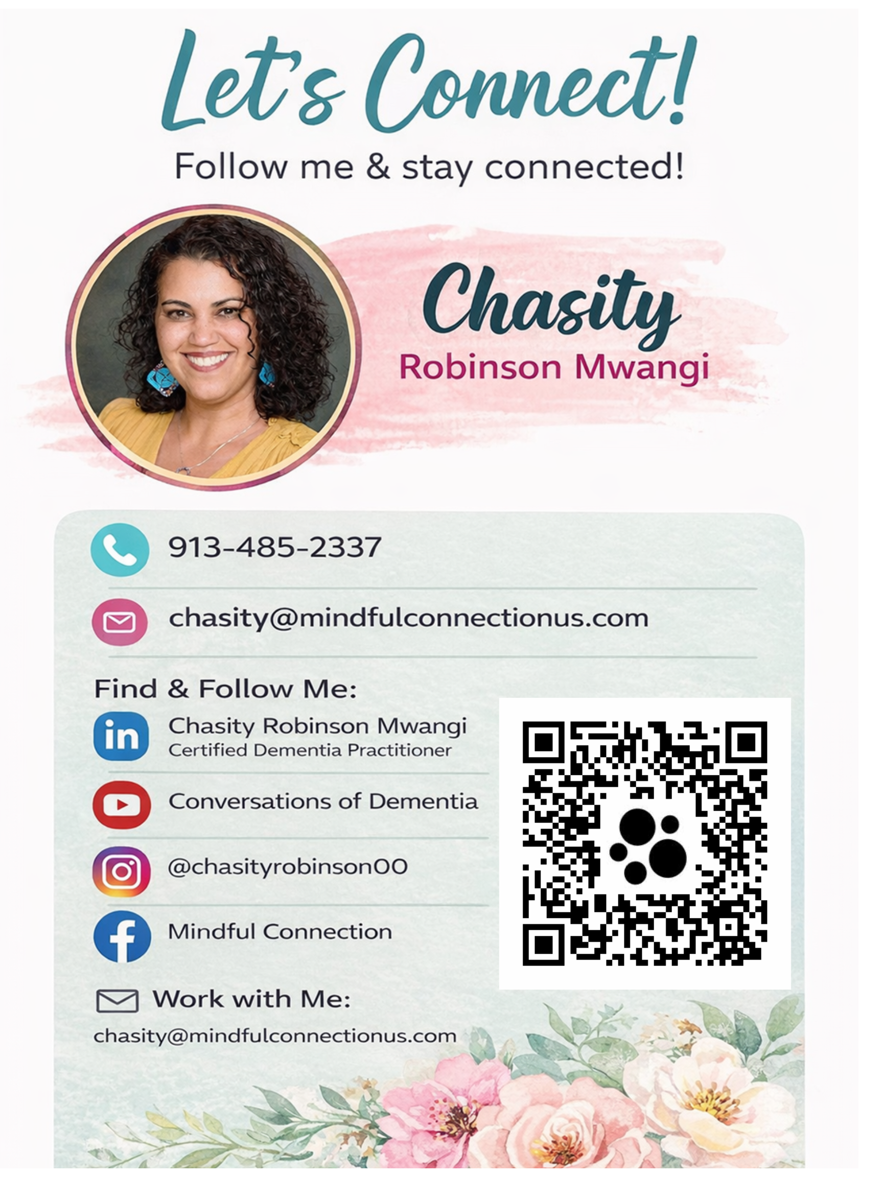
CONTACT & NEXT STEPS
Let’s Connect
Stay connected for dementia education, caregiver support, and compassionate care resources.
PHONE
913-485-2337 (Text first)
EMAIL
chasity@mindfulconnectionus.com
Mindful Connection
SCAN THE QR CODE
Thank you for staying connected — use the QR code for social links and follow-up resources.
Follow, connect, or share resources.
Notes:
CONTACT — ~30 sec
If you want to talk privately, here is how to reach me. There is no question too small. There is no situation too far gone. I have walked with families who thought they had nowhere to turn — there is always a next step.
God bless you and thank you again to United Believers!

Slide 23
CLOSING REFLECTION
THANK YOU
QUESTIONS &
CONVERSATION
For families navigating dementia.
What questions, concerns, or next steps would be helpful to talk through together?
“The Lord is near to the brokenhearted.”
Psalm 34:18
Thank you for learning, listening, and supporting families with compassion.
OPEN DISCUSSION
Questions & conversation
Notes:
THANK YOU & Q&A — ~1 min + Q&A
“The Lord is near to the brokenhearted."— Psalm 34:18
Thank you for walking alongside me — and alongside the families navigating dementia in this church.
ONE CHALLENGE before opening the floor: If anything, I said today made you think of someone — write their name down or put it on your bulletin right now. Then before this week is out, call them.
Now open Q&A.

